Slide 1
New Member Orientation

Slide 2
New Member Orientation
Table of Contents
Welcome
Positive Pathways Program
DCF Tuition and Fee Exemptions
Students Receiving DCF Tuition Exemptions (FCS)
Students Receiving DCF Tuition Exemptions (SUS)
Campus-Based Programs
Florida Reach
Value of Association
Expectations of Members
Educate Tomorrow Corporation
Program Leadership
Monthly Conference Calls
Annual Conference
Newsletter
Website
Facebook Group Page
How to Join Positive Pathways

Slide 3
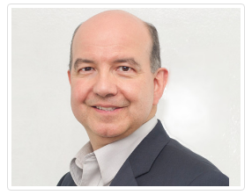
Welcome!
As a foster care liaison, you have been given access to a population of students who need you – and who will inspire you. Foster care liaisons encourage, guide, and support students eligible to receive Florida’s Tuition and Fee Exemption.
These resilient students often experience a unique set of barriers, and they possess power success strengths. Although Florida is experiencing increases in the number of students from foster care enrolling and graduating from post-secondary institutions, the percent of high school students in foster care who pursue postsecondary credentials is still small.
This orientation provide an overview of Positive Pathways, a program created and funded by the Florida Department of Children and Families (DCF) to support foster care liaisons on campuses from Panama City to Key West. Few other states in the national have this kind of program.
You are your institutions primary point of contact for these students as they begin a new chapter of their life – full of promise and possibilities, also many new unfamiliar challenges.
Together we can help these young transitioning adults reach their educational and life goals. Thank you for caring!
Dr. Steve J. Rios
Senior Director
Positive Pathways Program
Educate Tomorrow Corporation

Slide 4
Positive Pathways
The Positive Pathways Program was created by the Florida Department of Children and Families (DCF) to improve postsecondary outcomes and career transitions for former foster youth who are attending Florida’s public post-secondary educational system and eligible for the state’s generous tuition and fee exemption.
The Florida Legislature, in 2013, mandated that DCF collaborate with the Board of Governors (BOG), the Florida College System (FCS), and the Florida Department of Education (DOE) to help eligible youth transition to and through post-secondary educational settings (Chapter 409, Florida Statutes).
DCF contracted with Educate Tomorrow Corporation (ET), a 501(c)(3) organization, to manage the program.
Positive Pathways provides guidance, training, and technical assistance for all members. Members meet online every month, network, participate in workshops, and attend an annual conference to strengthen relationships with colleagues throughout Florida and learn about effective ways to serve students from foster care.

Slide 5
DCF Tuition and Fee Exemptions
The State of Florida provides tuition and fee exemptions to eligible students. The waiver is authorized at State (public) Universities, Colleges (public) in the Florida College System, and School District Workforce Education Programs. Fee exemptions are offered to students if he or she:
is or was in the custody of the Department of Children and Families when he or she reached age 18;
was adopted from the Department of Children and Families after May 5, 1997;
is or was at the time of reaching age 18 in the custody of a relative under s. 39.5085, F.S.;
is or was at the time of reaching age 18 in the custody of a non-relative under s. 39.5085, F.S.; or,
was placed in a guardianship by the court after spending at least 6 months in the custody of the department after reaching 16 years of age.
Note: The exemption remains valid until the student reaches 28 years of age. See § 1009.25(1)(c), (d), Fla. Stat.
For questions regarding eligibility or how to obtain a Tuition and Fee Exemption form, CF-FSP 5220, contact your local Community Based Care Lead Agency or call Florida’s Independent Living Resource Center.

Slide 6
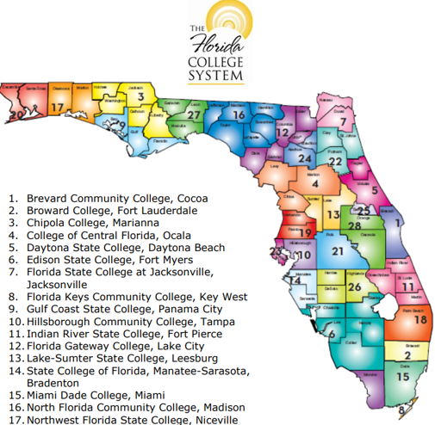
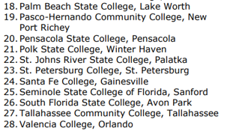

Slide 7
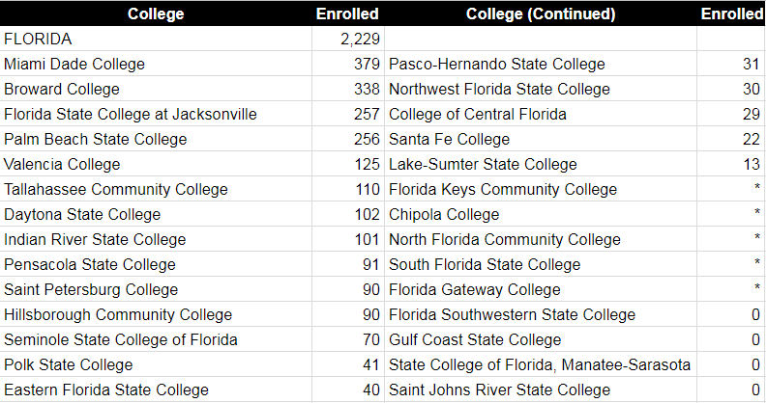
Students Receiving DCF Tuition Exemptions
Florida College System (FCS)
Academic Year 2015-2016
College | Headcount | College | Headcount
Source: Florida Department of Education, 2015-2016 Student Database. Notes: “*” indicates information has been masked to protect student privacy (values range between 1 and 9). “0” indicates no student at the FCS institution received DCF waivers.

Slide 8
Students Receiving DCF Tuition Exemptions
State University System (SUS)
Academic Year 2015-2016
University | Headcount
Florida A&M University | 107
Florida Atlantic University | 91
Florida Gulf Coast University | 41
Florida International University | 105
Florida State University | 68
New College of Florida | < 10
University of Florida | 33
University of Central Florida | 141
University of Florida | 53
University of North Florida | 33
University of South Florida | 82
University of West Florida | 64
Total | 785
Source: 2015-16 SUS Fee Waiver Data Mart

Slide 9
Campus-Based Programs
One of PPP’s main objectives is to identify public colleges and universities where there is an urgent need for a dedicated program to serve students using the DCF Tuition and Fee Exemption. Fortunately, a number of college and universities with high numbers of students in this category , such as those shown on this page, have established programs to work specifically with this population. The leaders of these programs are experienced liaisons and active members of PPP and Florida Reach.
Educate Tomorrow@
Miami-Dade College Single Stop
TCC Fostering Academic
Achievement Fellows
Unconquered
Scholars Program
University of Central Florida Knight
Alliance Network
Machen Florida Opportunity Scholars Program
Educate Tomorrow @ Florida Atlantic University
Florida International University Fostering
Panther Pride

Slide 10
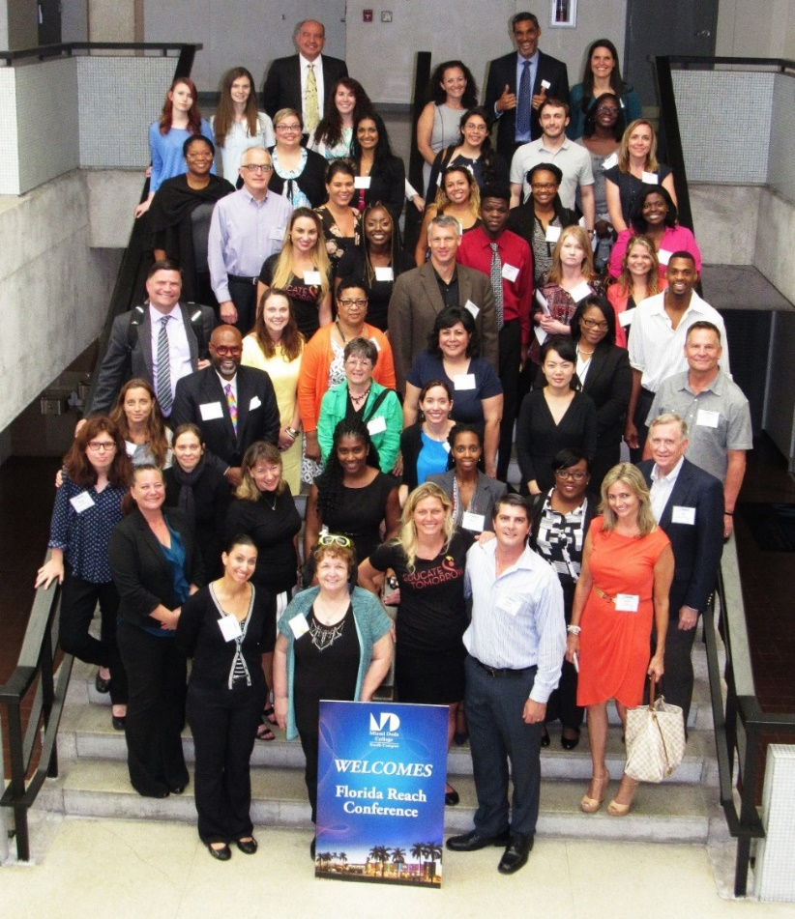
Florida Reach
PPP has partnered with Florida Reach, a state-wide network of students, community members, child welfare and educational professionals from all levels that are interested in helping youth and young adults in and from foster care succeed in school and life. DCF has been supporting Florida Reach, since 2013.
Partnering with Florida Reach has given PPP a platform on which to build and strengthen quality membership. Whereas PPP is a program with specific qualifications for participation, Florida Reach is an informal association of like-minded educational advocates. Florida Reach members are not obligated to participate in PPP.
Florida Reach Members at the 2016 Florida Reach Symposium.

Slide 11
Value of Association
PPP is, in essence, a professional association sponsored by DCF. Through this association you have access to like-minded colleagues striving to provide the best possible service to students receiving the DCF Tuition and Fee Exemption.
PPP headquarters can connect you to the right professionals at other campuses or with state level leaders who can help you quickly resolve challenges or questions you have, regarding serving former foster students on your campus.
PPP’s monthly calls provide immediate access to professionals in your field all over Florida. These professionals can help you answer pressing questions by providing you guidance and resources to help your students.
Together Florida Reach, PPP, DCF, DOE, BOG, and FCS are joining to provide an unprecedented amount of united action to serve student’s receiving the DCF Tuition and Fee Exemption.

Slide 12
Expectations of Members
The following activities represent some, but not all, of the things that members can do to support foster care alumni on their campus.
Work with foster care alumni with enrollment, financial aid applications, and exploration of career opportunities; and
Connect students with academic resources, scholarship opportunities, and community resources and support.
Notify key campus leaders (i.e., Student Services, Financial Aid, Casher’s Office, Registrar, Deans, etc.) that you are the designated campus contact for students utilizing the tuition and fee exemption;
Provide updates to changes at your institutions (i.e., potential additional members, programs available for foster care alumni);
Participate in monthly program conference calls;
Voice opinions and concerns on matters of importance related to the students;
Provide current contact information to program leaders;

Slide 13
Educate Tomorrow Corporation
ET was created in 2004 to serve current and former foster youth, homeless youth, and similarly disadvantaged young people by striving to make higher education an attainable goal for all.
ET’s programs primarily serve these youth and young adults by providing multi-year, goal-oriented academic and career coaching, intensive skill-building workshops and enrichment activities.
As the contracted provider for PPP, ET is responsible for ensuring that PPP operates efficiently and effectively so that you will always have the support that you need to serve the students on your campus from foster care.

Slide 14
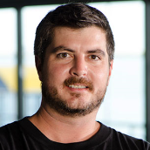
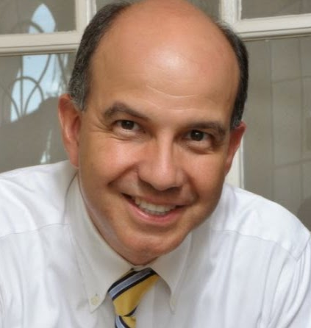
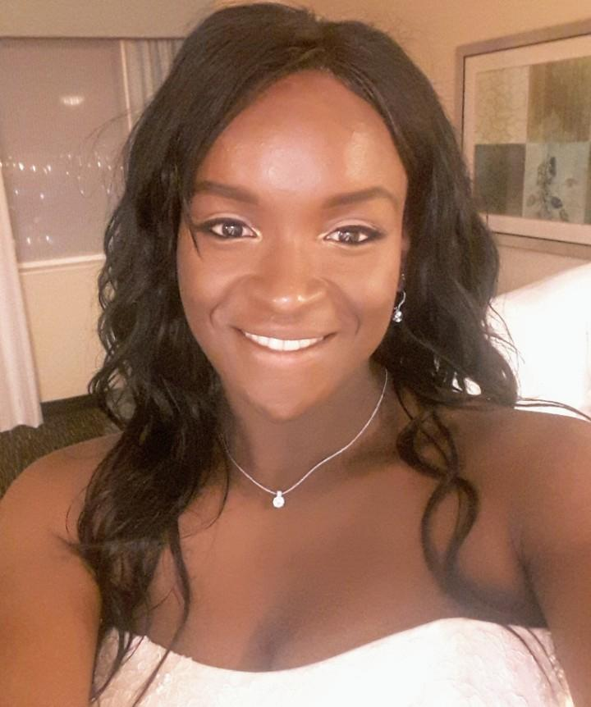
Positive Pathways Program Staff
Brett McNaught, PPP Supervisor, is CEO of ET, a Miami-Dade County based 501c3 that serves disadvantaged and foster youth through education, mentoring and the life skills training. Brett has an M.S.Ed in Community and Social Change from the University of Miami. He is on the board of buildOn and Learning 1 to 1 Foundation, and was on the board of the Miami-Dade County Community Based Care Alliance from 2012-2016. He is co-chair of the Education and Employment committee for the Miami-Dade County Homeless Youth Collective Impact.
Dr. Steve J. Rios, Senior Director of PPP, is a long-time youth advocate. He has mentored a number of students to and through college, and helped one through her law degree. Dr. Rios holds a master’s degree in Public Administration and a Doctorate in Adult Education and Human Resource Development. In 2013, Dr. Rios co-founded Florida Reach, a network service former foster youth who are in college. He is a leader of the national movement of state-level efforts to connect child welfare and higher education professional to support former foster youth on campuses.
Tracy Adirika is a freshman at Miami Dade College studying pre-medicine with hopes of attending medical school. She is a Changemaker Corps student leader and believes in the power and influence of peer mentorship and community service. Tracy is the Program Assistant for the AOK Scholars and Positive Pathways Network at Educate Tomorrow. She is a mother of two and caretaker to her four siblings.

Slide 15
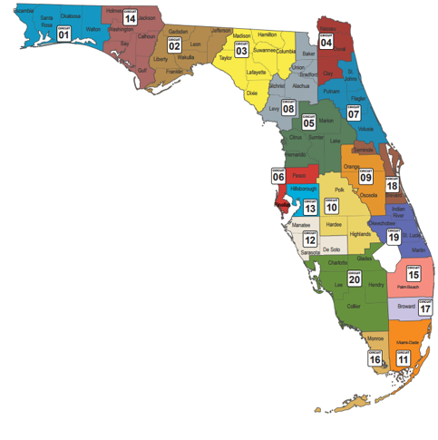
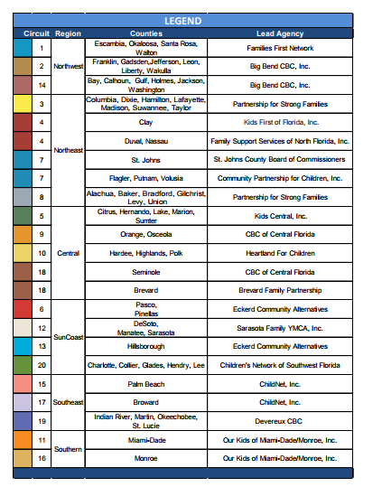
Community-based Care Agencies
The Florida Department of Children and Families contracts with Community-based care agencies throughout the state to provide child welfare services in their areas. Through these agencies, you can contact the independent living workers who will provide information about the young people in their care who may want to attend college. These agencies provide support for these young adults and can help foster care liaisons as they work with students receiving the tuition exemption.

Slide 16
Posts
Caption:
Positive Pathways is here to provide you with
training, networking opportunities, and technical
support you need to be effective in this new role as
a foster care liaison.
Join our monthly network conference call for more
information and to network with counterparts
throughout Florida.

Slide 17
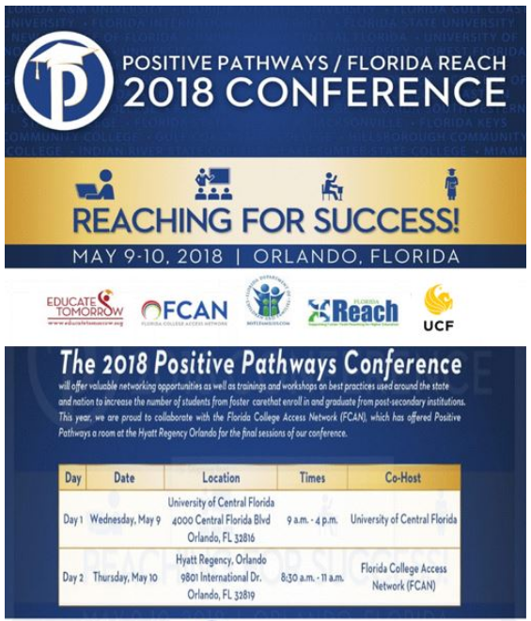
Annual Conference
Each year, the PPP will host a conference for its members, partners, and others interested in the Program’s work. The conference provides a valuable networking opportunity as well as trainings and workshops on best practices that are being used around the state and nation to increase the number of students from foster care that enroll in and graduate from post-secondary institutions.

Slide 19
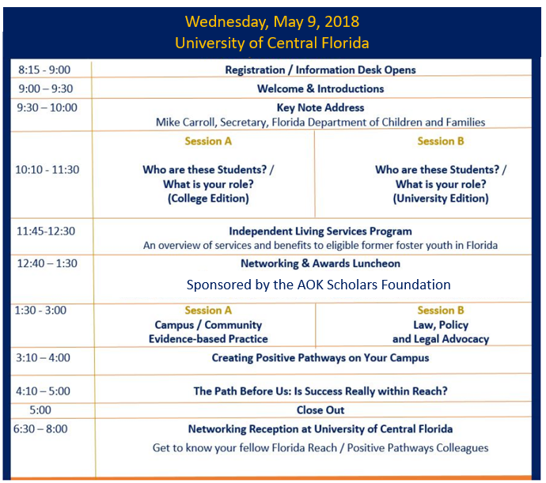
Annual Conference – Agenda and Vision Meeting
Thursday, May 10, 2018
Hyatt Regency Orlando

Slide 20
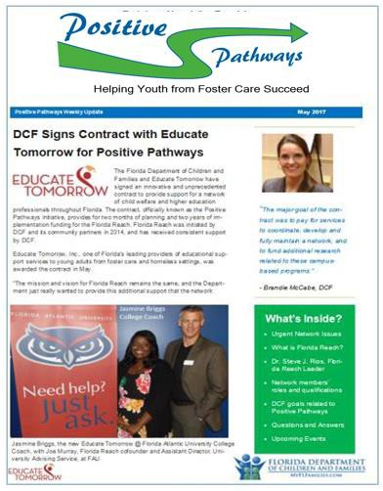
Newsletter
Our quarterly newsletter, The Path, includes the following sections to keep members informed about the program’s work and activities. Feel free to submit information to be included!
Lead Story or Stories
A directory of members
New member introduction stories
Profiles of members, partners, and programs
Legislative / Regulation Updates
Question and Answers
Upcoming Events
Success Stories
Good News
Research

Slide 21
Website
www.PositivePathwaysFlorida.org

Slide 22
Facebook Group Page
Our Facebook page serves as platform to inform and update program members.
The Facebook group page provides an immediate way for program leadership to provide important announcements to all members, partners, and interested parties. Users can join the group, post their thoughts on a wall, and interact through discussion threads.

Slide 23
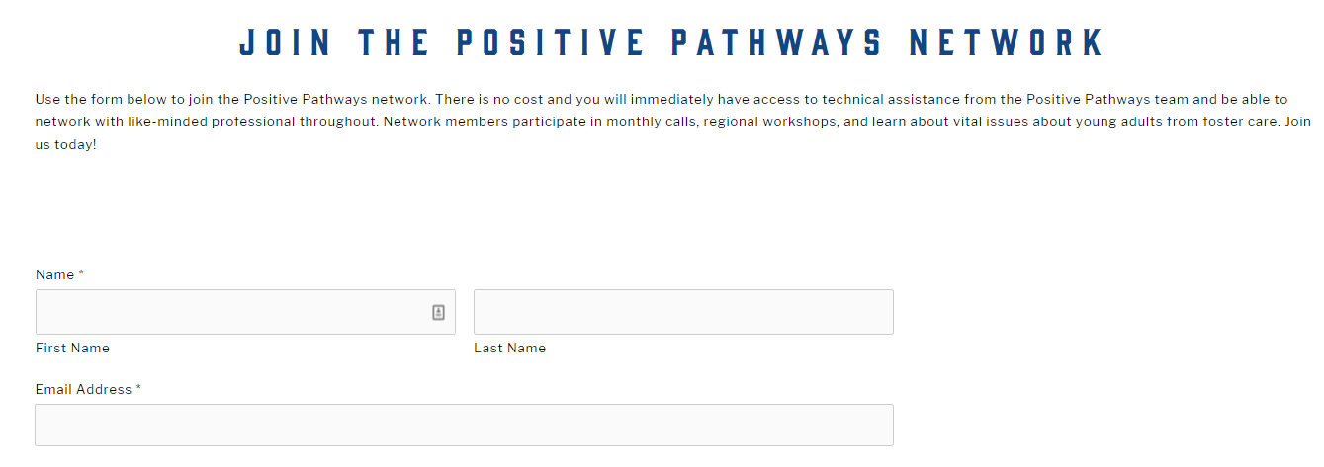
Welcome to Positive Pathways! To join, click here

